Slide 1
Movie Recommendation System
Major
Project
Submitted By –
Argho Das (10617210005)
Devjyoti Modak (10617210006)
Sahil Ahuja (10617210013)
Swapnil Johri (10617210016)
Mentor –
Mr. Vaibhav Sharma

Slide 2

Objective
To develop a complete movie recommendation system using Content –based and Collaborative based filtering and presenting an interactive UI for the same.

Slide 3

About the Project
What is a Recommendation System ?
Simply put a recommendation system is a filtration program whose prime goal is to predict the “rating” or “preference” of a user towards a domain-specific item or item.
In our case, this domain-specific item is a movie, therefore the main focus of our recommendation system is to filter and predict only those movies which a user would prefer given some data about the user him or herself.

Slide 4
About the Project (Cont.)
Recommendation system implements various machine learning algorithms through which the system recommends/suggests the users with various recommendations. There are a variety of machine learning algorithms in the industry, the ones which are used in the project are as follows:
Content Based Filtering Algorithm
Collaborative Based Filtering Algorithm

Slide 5






Technologies Used
Platforms Used
Graphical User Interface
Jupyter Notebook
Machine Learning
Microsoft Excel
Dashboard
Power BI

Slide 6
Team Members and
their Responsibilities
Team Mate A
Team Mate B
Team Mate C
Team Mate D
Devjyoti
Sahil
Swapnil
Argho
Responsible for developing the GUI as well as contributing in Data Pre-Processing.
Responsible for Data Collection and Data Pre-Processing.
Responsible for implementing machine learning models.
Responsible for developing dynamic dashboard.

Slide 7
Flowchart
Training and Validation Datasets
State the user response
User
Interaction
Real Time User Data
User Interface
Excel Sheets
Machine Learning Models
Output
Dashboard

Slide 8
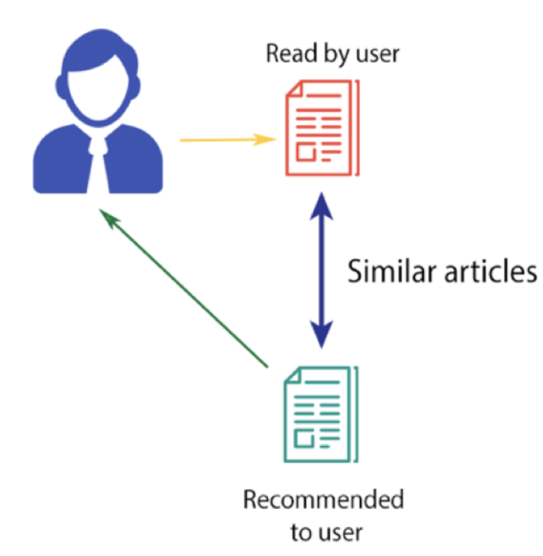

Algorithms Used
Content Based Filtering
Collaborative Based Filtering
It tries to guess the features or behavior of a user given the item’s features, he/she reacts positively to.
For example - people who have watched “liar liar” which is a comedy genre based movie would be recommended other movies like liar liar.
Collaborative filtering is a technique that can filter out items that a user might like on the basis of reactions by similar users.
For example - if there are two users both users like 2 movies but user 1 also likes a third movie which user 2 hasn’t watched, then that movie would be recommended to that user.

Slide 9
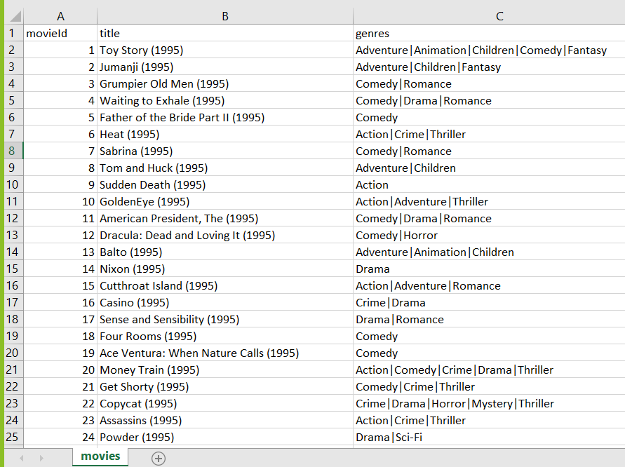
Data Collection
Raw Dataset – Movies.csv

Slide 10
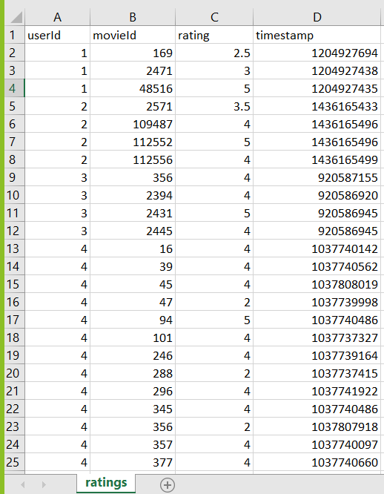
Data Collection
Raw Dataset – Ratings.csv

Slide 11
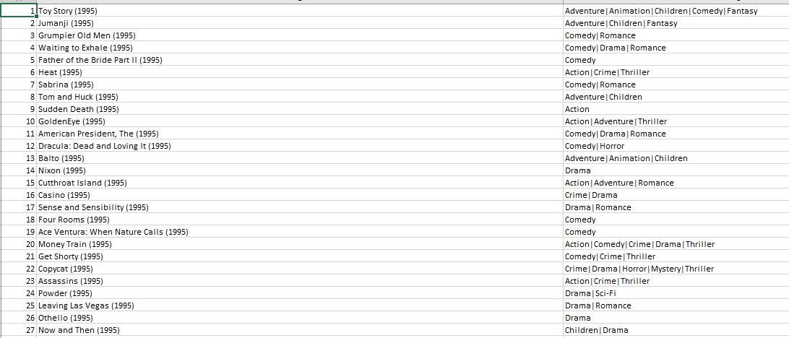
Data Pre-processing
Raw Dataset

Slide 12
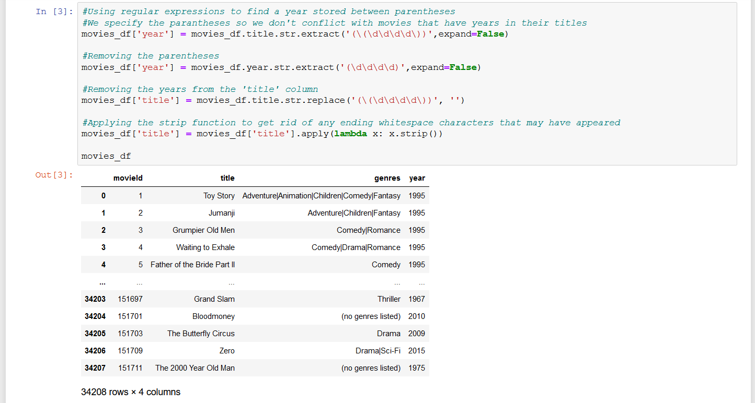
Data Pre-processing (Cont.)

Slide 13
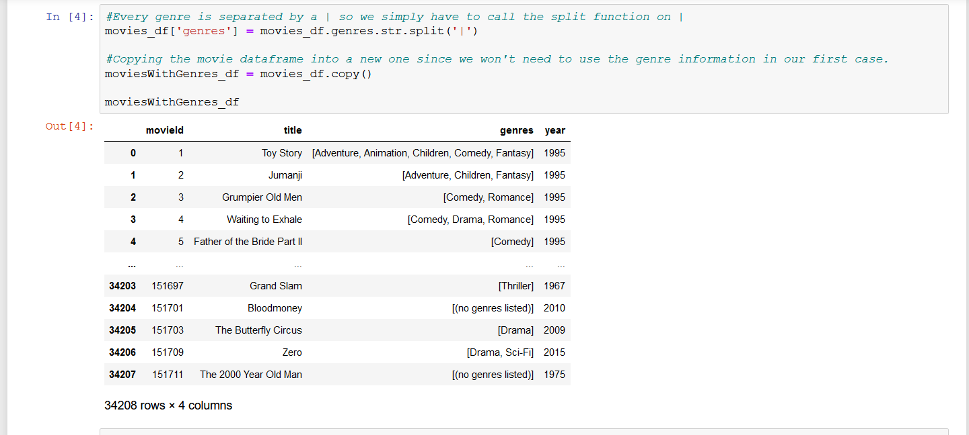
Data Pre-processing (Cont.)

Slide 14
Off to the working implementation of the project

Slide 15
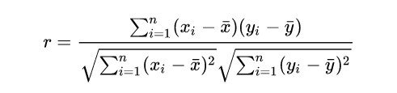
Pearson Correlation Coefficient.

Slide 16
Future Scope

Slide 17
Thank you!

